Slide 1
Linear Algebra for Data Science

Slide 2
Outline
Vectors and Matrices for Data Science
Properties of Vectors
Properties of Matrices
Matrix Subspaces
Rank and Nullity
Eigenvalues, Eigenvectors and Eigenvalue Decomposition
Singular Values, Singular Vectors and Singular Value Decomposition
Vector and Matrix properties applied to Data Science
Pre-requisites: Transpose, Determinant, Inverse and Multiplication of Matrices, and Types of matrices such as Identity, Symmetric, Diagonal, etc.

Slide 3
Vectors and Matrices for Data Science

Slide 4

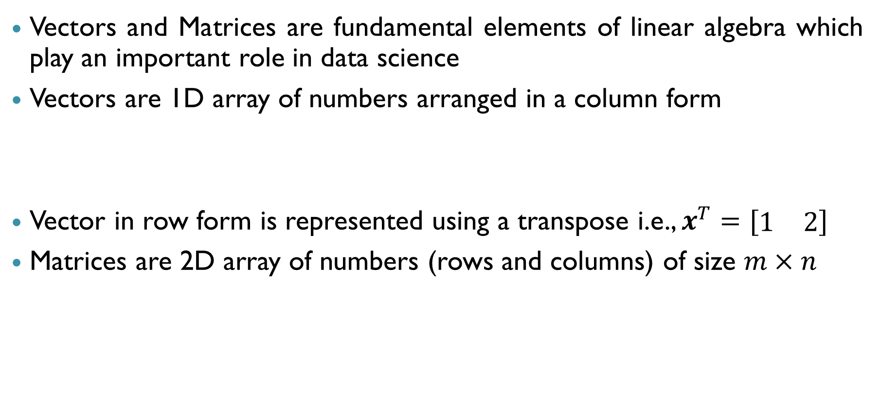
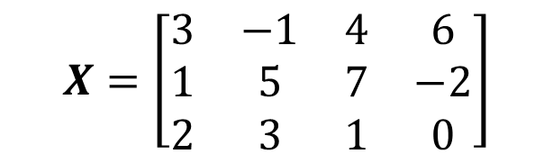
Vectors and Matrices
Vectors and Matrices are fundamental elements of linear algebra which play an important role in data science
Vectors are 1D array of numbers arranged in a column form
Vector in row form is represented using a transpose i.e., $x^{T}=[\begin{matrix}1 & 2\end{matrix}]$
Matrices are 2D array of numbers (rows and columns) of size $m×n$
$$x=\left[\begin{matrix}1 \\ 2\end{matrix}\right]$$
$$X=\left[\begin{matrix}3 & −1 & 4 & 6 \\ 1 & 5 & 7 & −2 \\ 2 & 3 & 1 & 0\end{matrix}\right]$$

Slide 5
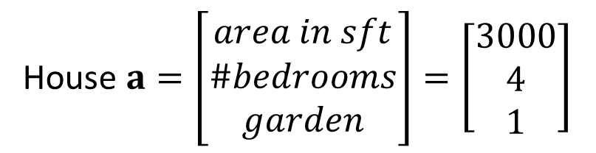
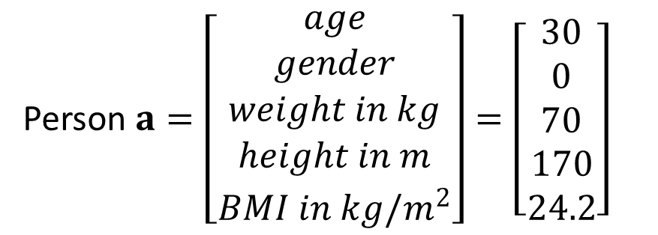
Vectors for Data representation
Vectors are useful to represent data which has more than one feature (variable)
Encode information in a format which ML models can process
Examples:
Vector containing features of a person: age, gender, weight, height, BMI, etc.
Vector containing features of a house: area, number of bedrooms, garden present or not, etc.
Person $a=\left[\begin{matrix}age \\ gender \\ weight in kg \\ height in m \\ BMI in kg/m^{2}\end{matrix}\right]=\left[\begin{matrix}30 \\ 0 \\ 70 \\ 170 \\ 24.2\end{matrix}\right]$
House $a=\left[\begin{matrix}area in sft \\ \#bedrooms \\ garden\end{matrix}\right]=\left[\begin{matrix}3000 \\ 4 \\ 1\end{matrix}\right]$

Slide 6

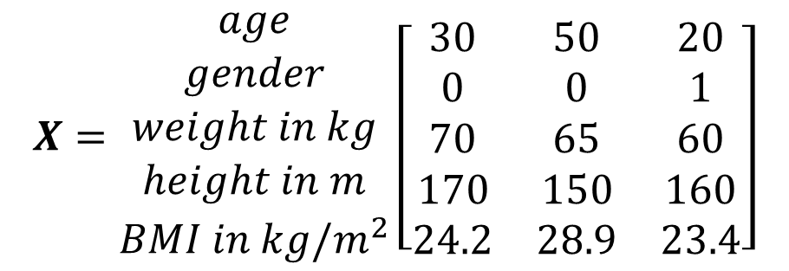
Matrices for Data representation
Generally, data contains multiple samples (feature vectors)
Therefore, the features vectors are stacked together into a matrix
Feature vectors may be stacked as rows or columns of a matrix
Referred to as data matrix
When a data matrix is manipulated, the interpretation depends on the representation
$$\begin{matrix}\begin{aligned}Person \\ a\end{aligned} & \begin{aligned}Person \\ b\end{aligned} & \begin{aligned}Person \\ c\end{aligned}\end{matrix}$$
$$X=\begin{matrix}age \\ gender \\ weight in kg \\ height in m \\ BMI in kg/m^{2}\end{matrix}\left[\begin{matrix}30 & 50 & 20 \\ 0 & 0 & 1 \\ 70 & 65 & 60 \\ 170 & 150 & 160 \\ 24.2 & 28.9 & 23.4\end{matrix}\right]$$
Data Matrix with features (variables)
along rows and samples along columns

Slide 7
Algebraic Visualisation and Properties of Vectors

Slide 8
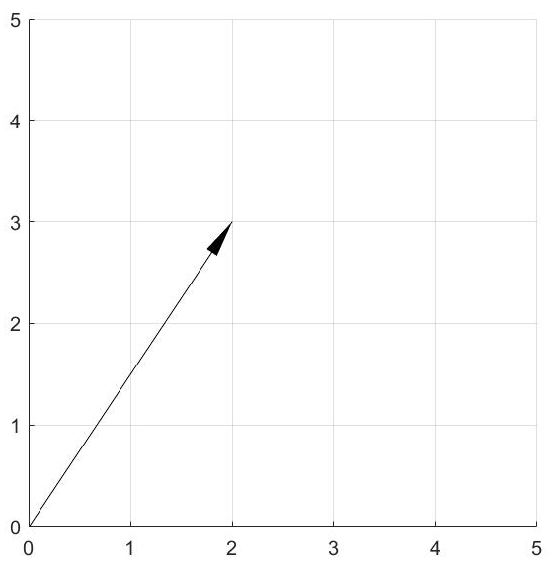

Vectors in Vector Space
2D Vector
Elements (components) of a vector can be represented in a coordinate space (Vector space)
Each element of the vector corresponds to a dimension in the vector space
$$x=\left[\begin{matrix}2 \\ 3\end{matrix}\right]$$

Slide 9
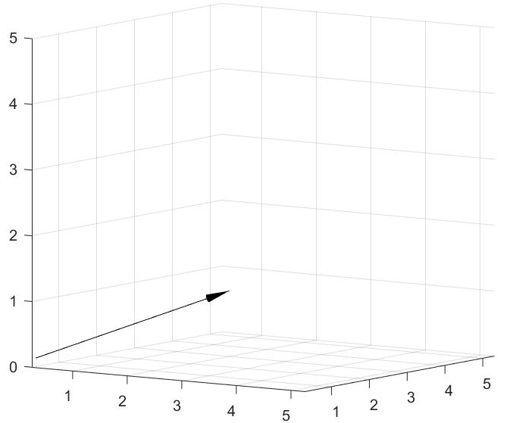

Vectors
3D Vector
Elements (components) of a vector can be represented in a coordinate space (Vector space)
Each element of the vector corresponds to a dimension in the vector space
$$x=\left[\begin{matrix}2 \\ 3 \\ 1\end{matrix}\right]$$

Slide 10

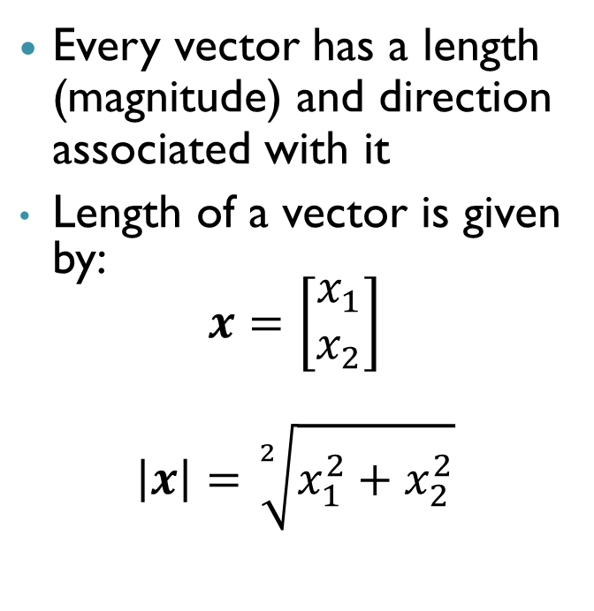

Length and Direction of Vectors
Length and Direction of a 2D Vector
Every vector has a length (magnitude) and direction associated with it
Length of a vector is given by:
$$x=\left[\begin{matrix}x_{1} \\ x_{2}\end{matrix}\right]$$
$$\left|x\right|=\sqrt[2]{x_{1}^{2}+x_{2}^{2}}$$
$$x=\left[\begin{matrix}2 \\ 3\end{matrix}\right]$$
$$|x|=\sqrt{13}$$

Slide 11
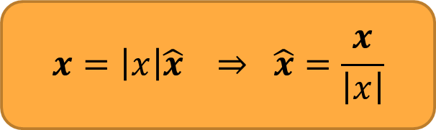
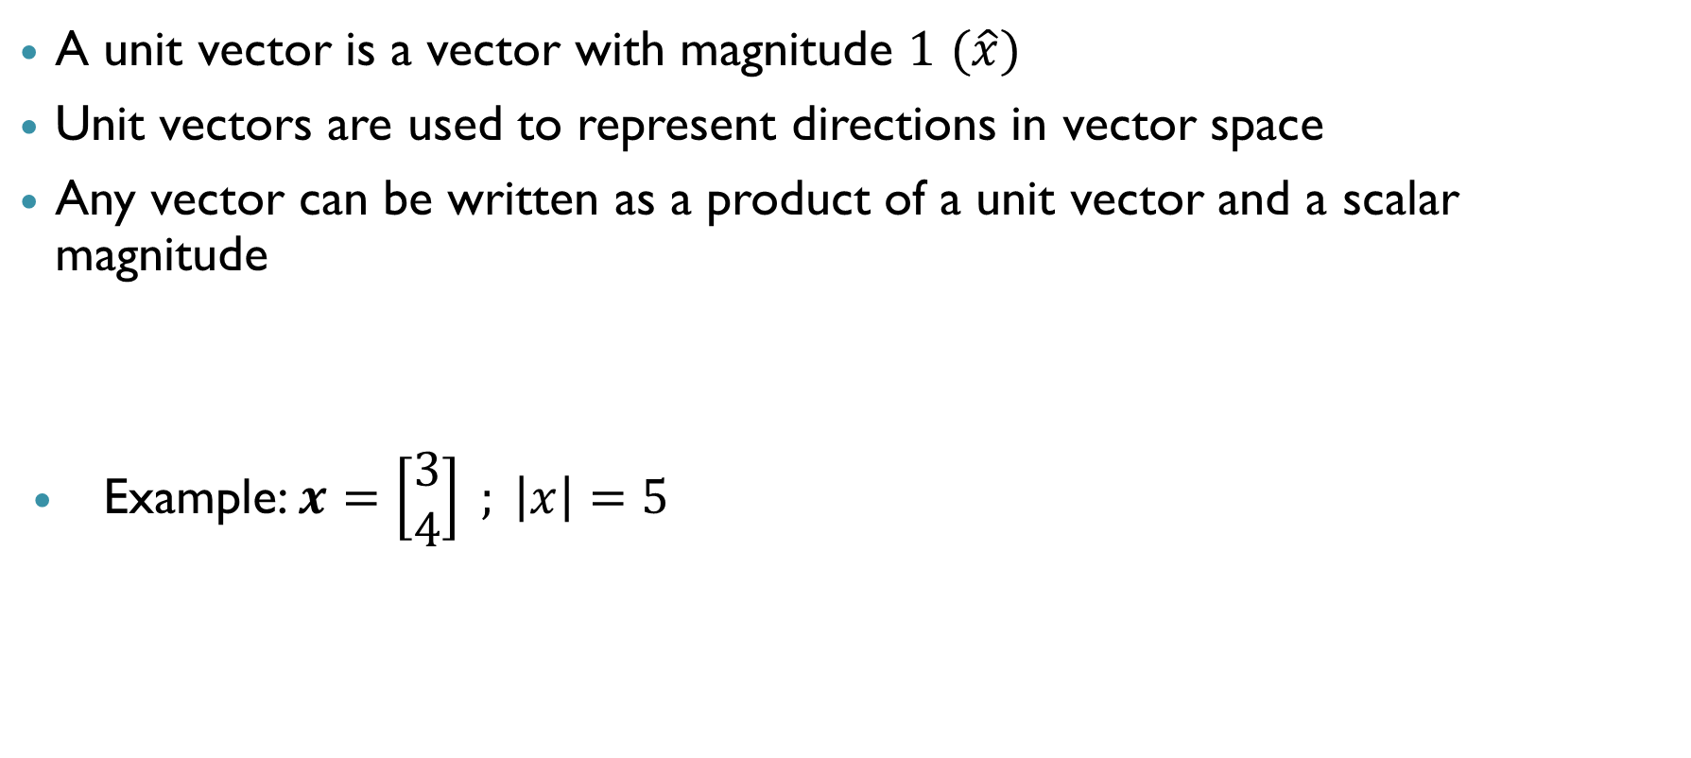

Unit vector
A unit vector is a vector with magnitude $1$ $(\hat{x})$
Unit vectors are used to represent directions in vector space
Any vector can be written as a product of a unit vector and a scalar magnitude
Example: $x=\left[\begin{matrix}3 \\ 4\end{matrix}\right] ; \left|x\right|=5$
$$x=\left|x\right|\hat{x} ⇒ \hat{x}=\frac{x}{\left|x\right|}$$
$$\hat{x}=\frac{x}{\left|x\right|}=\left[\begin{aligned}3/5 \\ 4/5\end{aligned}\right]$$

Slide 12
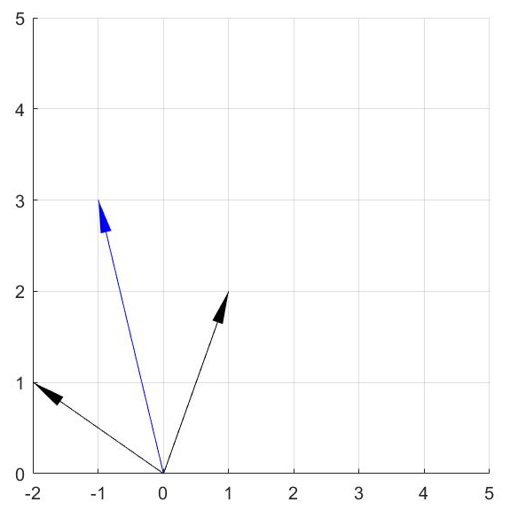
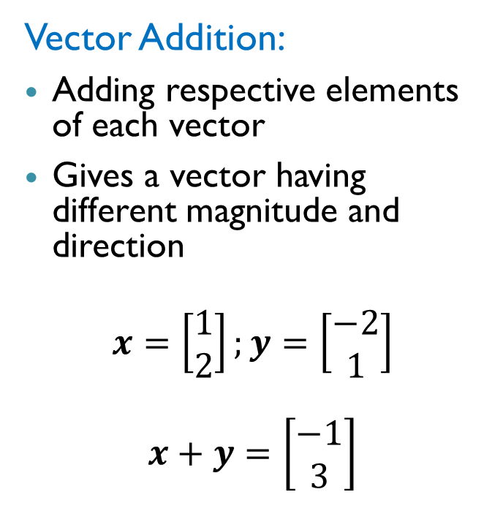
Properties of Vectors
2D Vector Addition
Vector Addition:
Adding respective elements of each vector
Gives a vector having different magnitude and direction
$$x=\left[\begin{matrix}1 \\ 2\end{matrix}\right];y=\left[\begin{matrix}−2 \\ 1\end{matrix}\right]$$
$$x+y=\left[\begin{matrix}−1 \\ 3\end{matrix}\right]$$

Slide 13
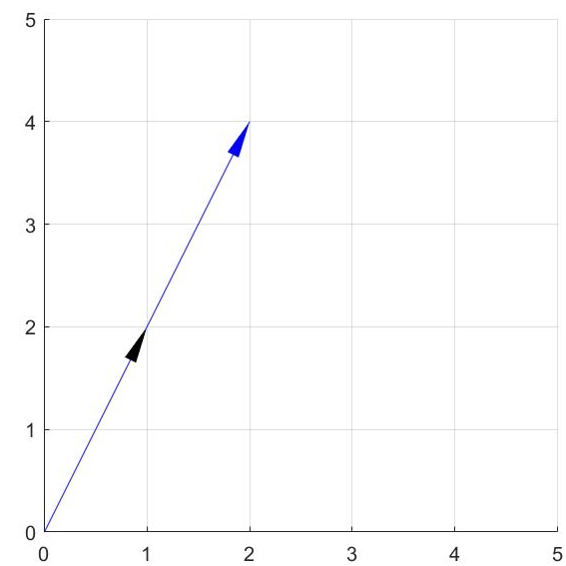
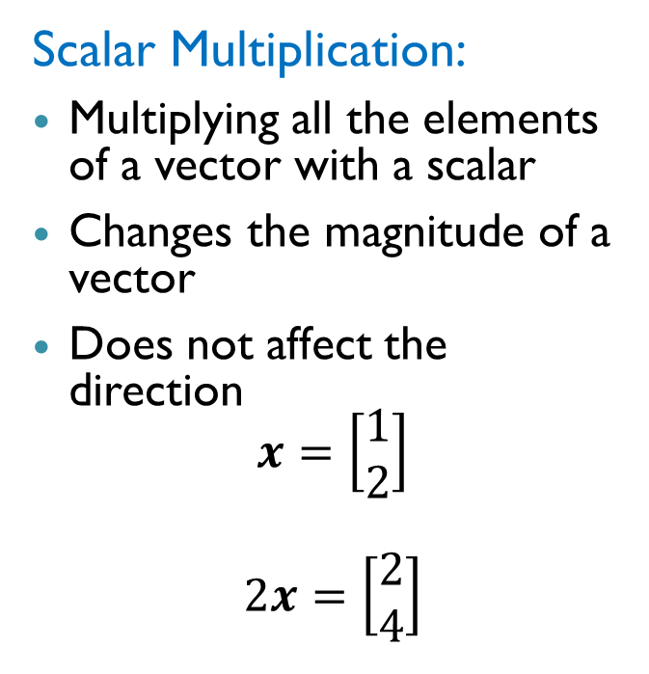
Properties of Vectors
Scalar Multiplication of 2D Vector
Scalar Multiplication:
Multiplying all the elements of a vector with a scalar
Changes the magnitude of a vector
Does not affect the direction
$$x=\left[\begin{matrix}1 \\ 2\end{matrix}\right]$$
$$2x=\left[\begin{matrix}2 \\ 4\end{matrix}\right]$$

Slide 14
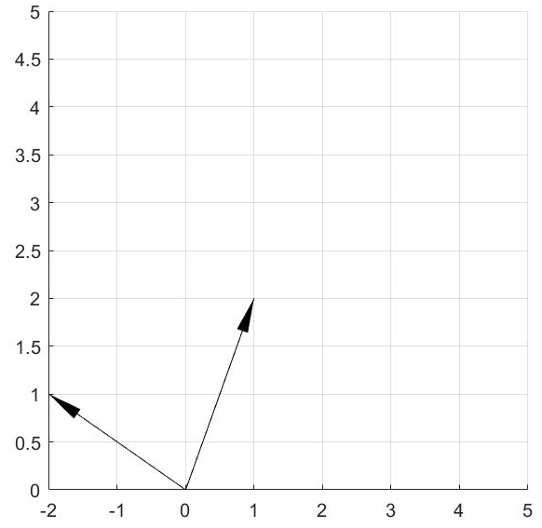
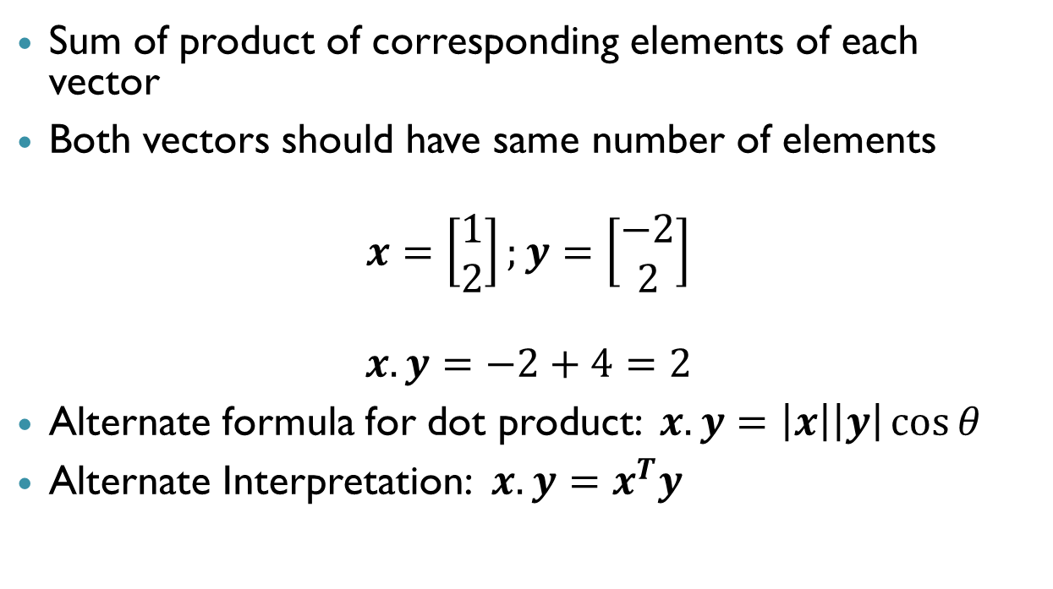

Properties of Vectors: Dot Product
Sum of product of corresponding elements of each vector
Both vectors should have same number of elements
$$x=\left[\begin{matrix}1 \\ 2\end{matrix}\right];y=\left[\begin{matrix}−2 \\ 2\end{matrix}\right]$$
$$x.y=−2+4=2$$
Alternate formula for dot product: $x.y=\left|x\right|\left|y\right|\cos{θ}$
Alternate Interpretation: $x.y=x^{T}y$
$$θ$$

Slide 15
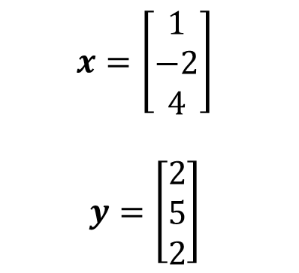
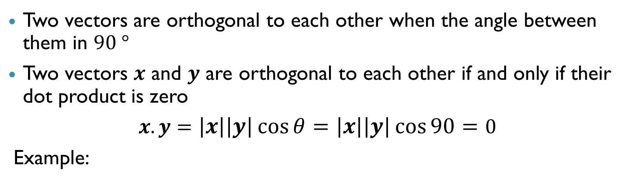

Orthogonal vectors
Two vectors are orthogonal to each other when the angle between them in $90 °$
Two vectors $x$ and $y$ are orthogonal to each other if and only if their dot product is zero
$x.y=\left|x\right|\left|y\right|\cos{θ}=\left|x\right|\left|y\right|\cos{90}=0$
Example:
$$x=\left[\begin{aligned}1 \\ −2 \\ 4\end{aligned}\right]$$
$$y=\left[\begin{aligned}2 \\ 5 \\ 2\end{aligned}\right]$$
$$x.y=2−10+8=0$$

Slide 16

Orthonormal vectors
Orthonormal vectors are orthogonal vectors with unit magnitude
Example
$$x=\left[\begin{matrix}1 \\ 0 \\ 0\end{matrix}\right] ;y=\left[\begin{matrix}0 \\ 1 \\ 0\end{matrix}\right]$$
$\left|x\right|=\left|y\right|=1 ;x.y=0$

Slide 17
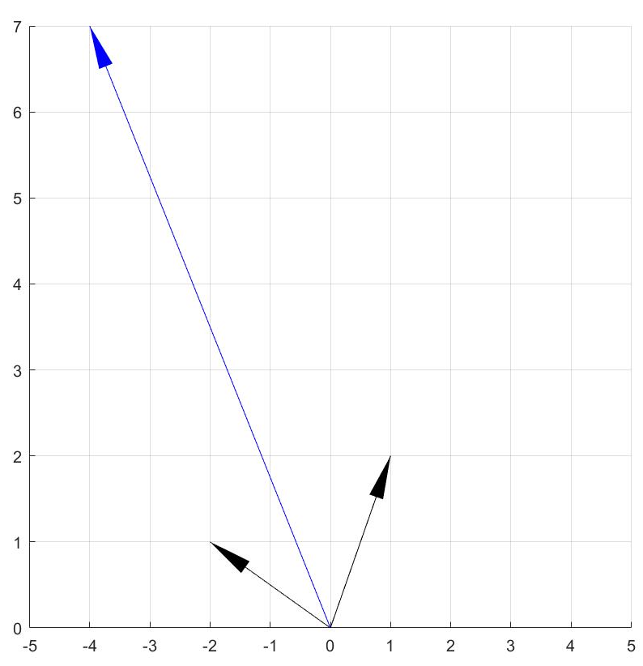
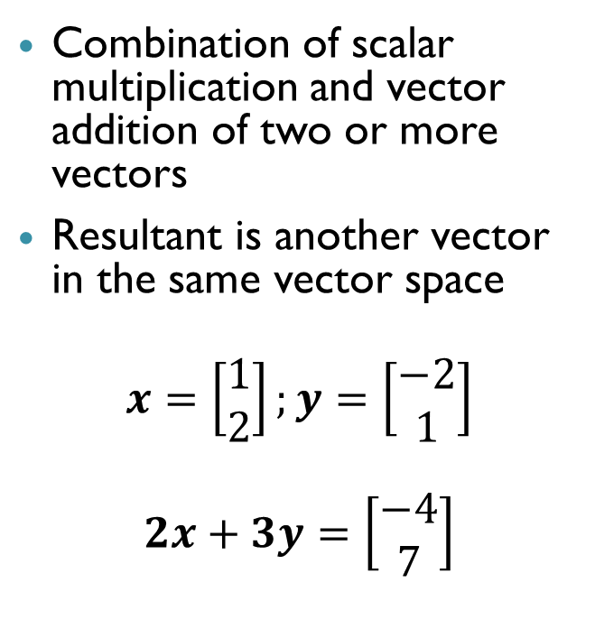
Linear Combination of Vectors
Linear Combination of 2D Vectors
Combination of scalar multiplication and vector addition of two or more vectors
Resultant is another vector in the same vector space
$$x=\left[\begin{matrix}1 \\ 2\end{matrix}\right];y=\left[\begin{matrix}−2 \\ 1\end{matrix}\right]$$
$$2x+3y=\left[\begin{matrix}−4 \\ 7\end{matrix}\right]$$

Slide 18
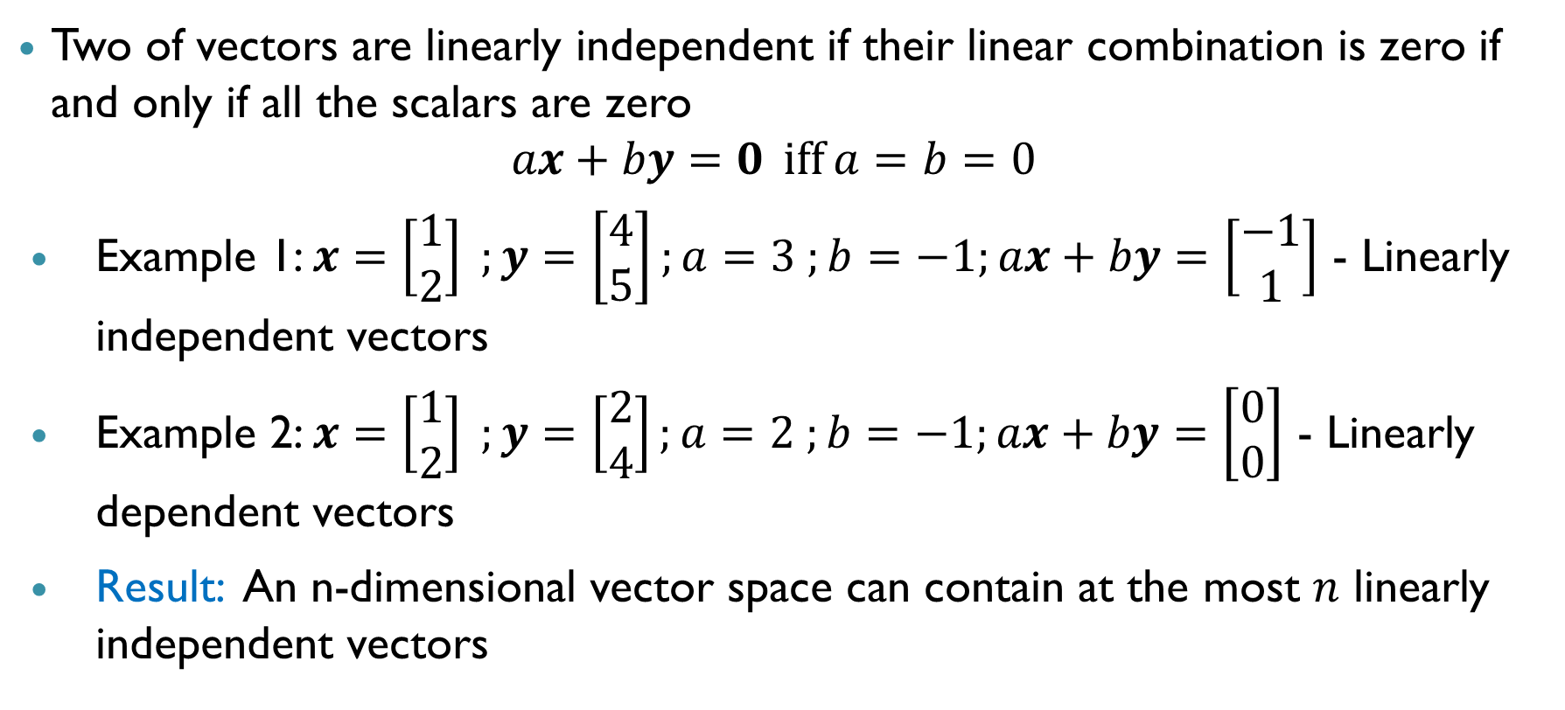
Linearly Independent Vectors
Two of vectors are linearly independent if their linear combination is zero if and only if all the scalars are zero
$$ax+by=0 \operatorname{iff}{a=b=0}$$
Example 1: $x=\left[\begin{matrix}1 \\ 2\end{matrix}\right] ;y=\left[\begin{matrix}4 \\ 5\end{matrix}\right];a=3 ;b=−1;ax+by=\left[\begin{matrix}−1 \\ 1\end{matrix}\right]$ - Linearly independent vectors
Example 2: $x=\left[\begin{matrix}1 \\ 2\end{matrix}\right] ;y=\left[\begin{matrix}2 \\ 4\end{matrix}\right];a=2 ;b=−1;ax+by=\left[\begin{matrix}0 \\ 0\end{matrix}\right]$ - Linearly dependent vectors
Result: An n-dimensional vector space can contain at the most $n$ linearly independent vectors

Slide 19
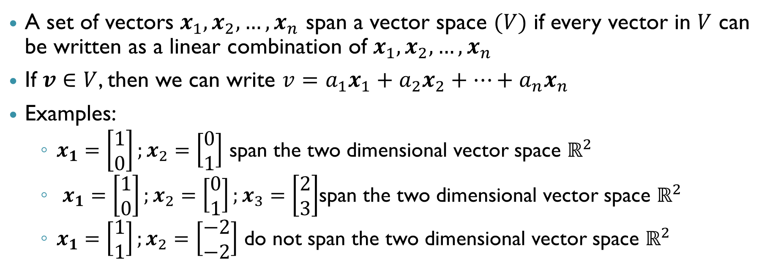
Span of a Vector Space
A set of vectors $x_{1},x_{2},…,x_{n}$ span a vector space $(V)$ if every vector in $V$ can be written as a linear combination of $x_{1},x_{2},…,x_{n}$
If $v∈V$, then we can write $v=a_{1}x_{1}+a_{2}x_{2}+…+a_{n}x_{n}$
Examples:
$x_{1}=\left[\begin{matrix}1 \\ 0\end{matrix}\right];x_{2}=\left[\begin{matrix}0 \\ 1\end{matrix}\right]$ span the two dimensional vector space $ℝ^{2}$
$x_{1}=\left[\begin{matrix}1 \\ 0\end{matrix}\right];x_{2}=\left[\begin{matrix}0 \\ 1\end{matrix}\right];x_{3}=\left[\begin{matrix}2 \\ 3\end{matrix}\right]$span the two dimensional vector space $ℝ^{2}$
$x_{1}=\left[\begin{matrix}1 \\ 1\end{matrix}\right];x_{2}=\left[\begin{matrix}−2 \\ −2\end{matrix}\right]$ do not span the two dimensional vector space $ℝ^{2}$
How many vectors are at least required to span a n-dim vector space and how should they be related?

Slide 20
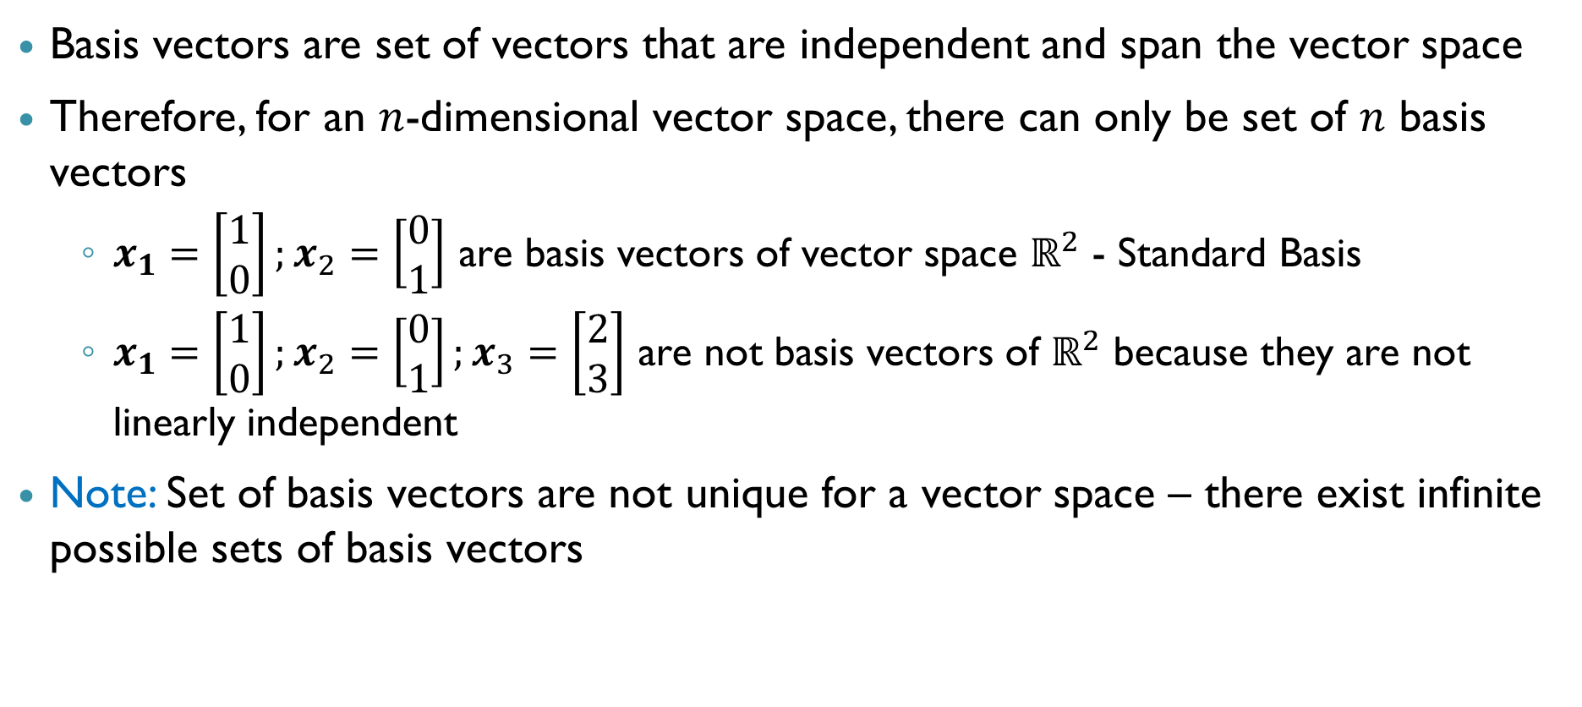
Basis vectors (Basis for a Vector Space)
Basis vectors are set of vectors that are independent and span the vector space
Therefore, for an $n$-dimensional vector space, there can only be set of $n$ basis vectors
$x_{1}=\left[\begin{matrix}1 \\ 0\end{matrix}\right];x_{2}=\left[\begin{matrix}0 \\ 1\end{matrix}\right]$ are basis vectors of vector space $ℝ^{2}$ - Standard Basis
$x_{1}=\left[\begin{matrix}1 \\ 0\end{matrix}\right];x_{2}=\left[\begin{matrix}0 \\ 1\end{matrix}\right];x_{3}=\left[\begin{matrix}2 \\ 3\end{matrix}\right]$ are not basis vectors of $ℝ^{2}$ because they are not linearly independent
Note: Set of basis vectors are not unique for a vector space – there exist infinite possible sets of basis vectors

Slide 21
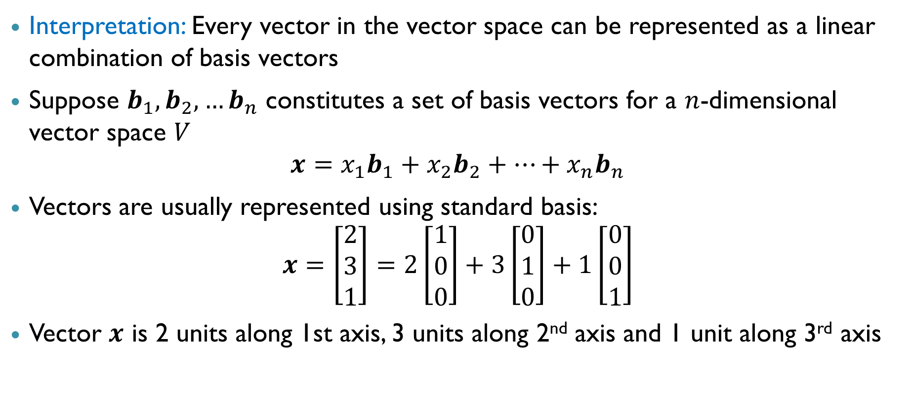
Basis vectors
Interpretation: Every vector in the vector space can be represented as a linear combination of basis vectors
Suppose $b_{1},b_{2},…b_{n}$ constitutes a set of basis vectors for a $n$-dimensional vector space $V$
$$x=x_{1}b_{1}+x_{2}b_{2}+…+x_{n}b_{n}$$
Vectors are usually represented using standard basis:
$$x=\left[\begin{matrix}2 \\ 3 \\ 1\end{matrix}\right]=2\left[\begin{matrix}1 \\ 0 \\ 0\end{matrix}\right]+3\left[\begin{matrix}0 \\ 1 \\ 0\end{matrix}\right]+1\left[\begin{matrix}0 \\ 0 \\ 1\end{matrix}\right]$$
Vector $x$ is 2 units along 1st axis, 3 units along 2nd axis and 1 unit along 3rd axis

Slide 22
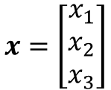
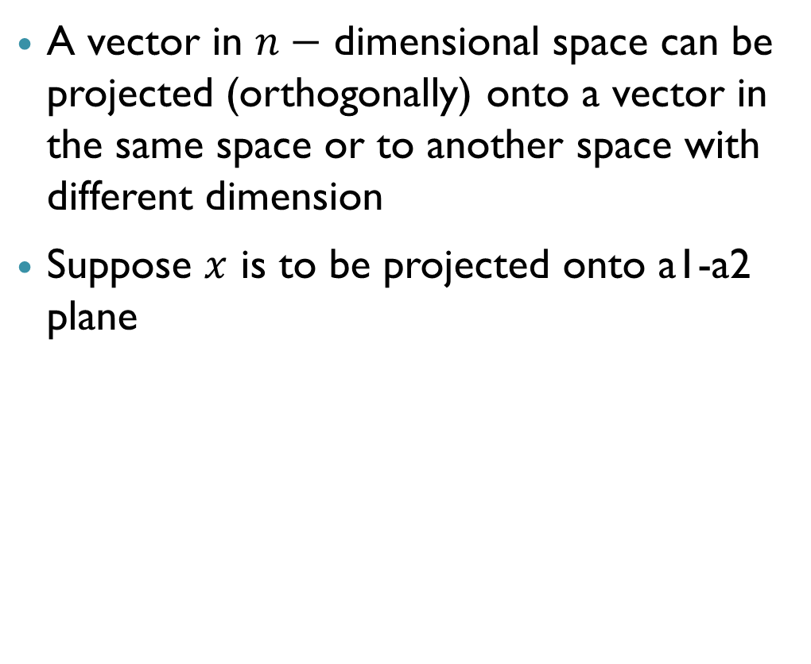



Projection of a Vector
$$a3$$
A vector in $n−$ dimensional space can be projected (orthogonally) onto a vector in the same space or to another space with different dimension
Suppose $x$ is to be projected onto a1-a2 plane
$$x=\left[\begin{matrix}x_{1} \\ x_{2} \\ x_{3}\end{matrix}\right]$$
$$a1$$
$$a2$$

Slide 23
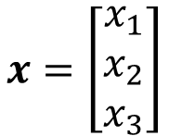
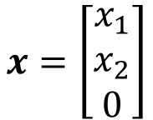
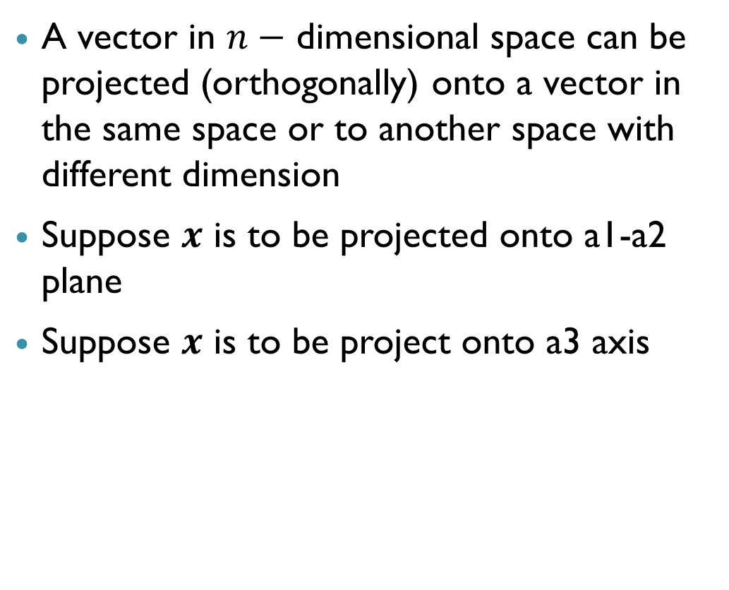
Projection of a Vector
$$a3$$
A vector in $n−$ dimensional space can be projected (orthogonally) onto a vector in the same space or to another space with different dimension
Suppose $x$ is to be projected onto a1-a2 plane
Suppose $x$ is to be project onto a3 axis
$$x=\left[\begin{matrix}x_{1} \\ x_{2} \\ x_{3}\end{matrix}\right]$$
$$a1$$
$$x=\left[\begin{matrix}x_{1} \\ x_{2} \\ 0\end{matrix}\right]$$
$$a2$$

Slide 24
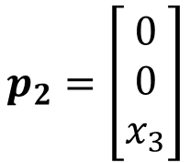
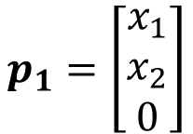
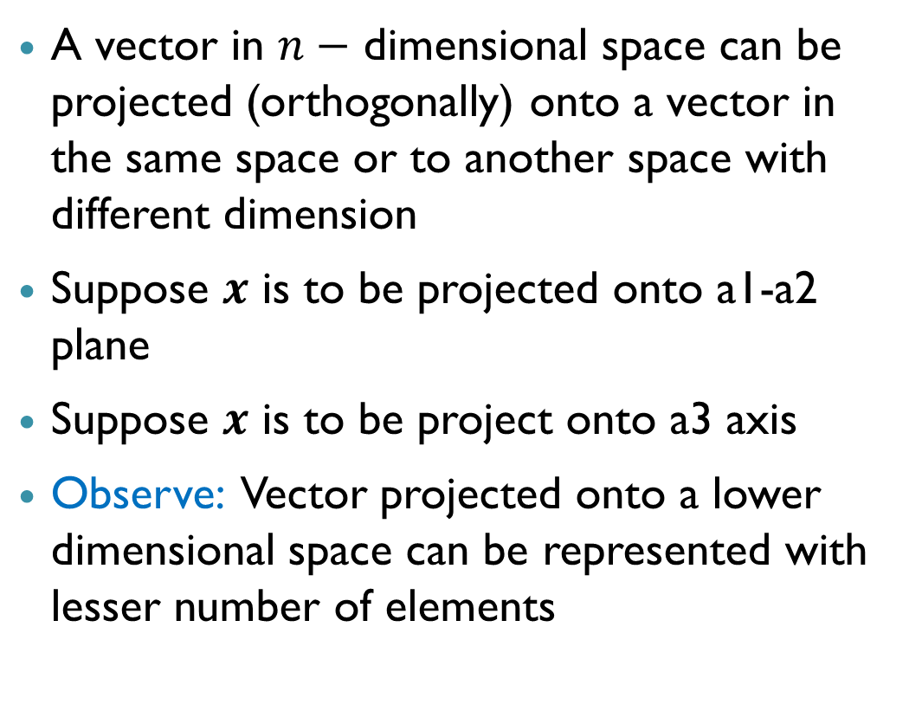
Projection of a Vector
$$a3$$
A vector in $n−$ dimensional space can be projected (orthogonally) onto a vector in the same space or to another space with different dimension
Suppose $x$ is to be projected onto a1-a2 plane
Suppose $x$ is to be project onto a3 axis
Observe: Vector projected onto a lower dimensional space can be represented with lesser number of elements
$$p_{2}=\left[\begin{matrix}0 \\ 0 \\ x_{3}\end{matrix}\right]$$
$$x=\left[\begin{matrix}x_{1} \\ x_{2} \\ x_{3}\end{matrix}\right]$$
$$a1$$
$$p_{1}=\left[\begin{matrix}x_{1} \\ x_{2} \\ 0\end{matrix}\right]$$
$$a2$$

Slide 25

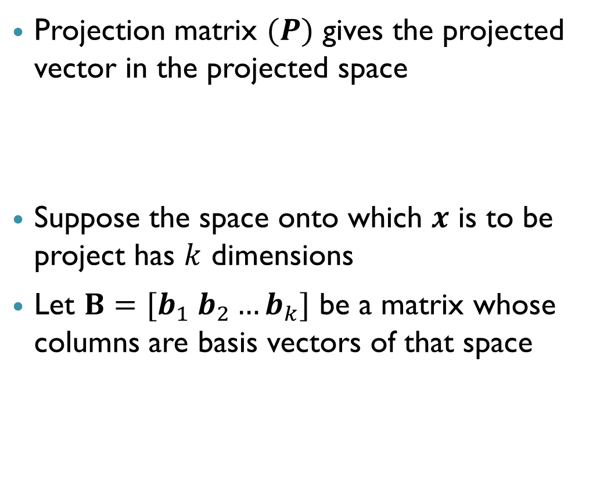
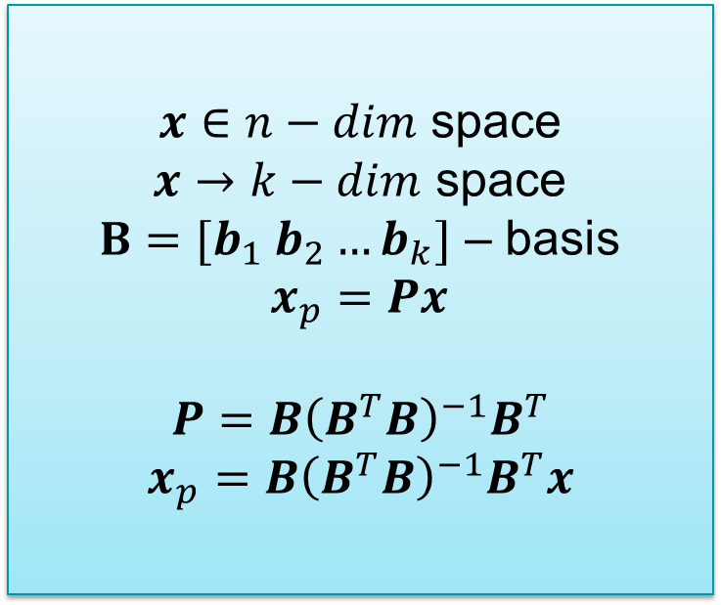
Projection Matrix
Projection matrix $(P)$ gives the projected vector in the projected space
Suppose the space onto which $x$ is to be project has $k$ dimensions
Let $B=[b_{1} b_{2}…b_{k}]$ be a matrix whose columns are basis vectors of that space
$x∈n−dim$ space
$x→k−dim$ space
$B=[b_{1} b_{2}…b_{k}]$ – basis
$x_{p}=Px$
$$P=B{\left(B^{T}B\right)}^{−1}B^{T}$$
$$x_{p}=B{\left(B^{T}B\right)}^{−1}B^{T}x$$
$$x_{p}=Px$$

Slide 26
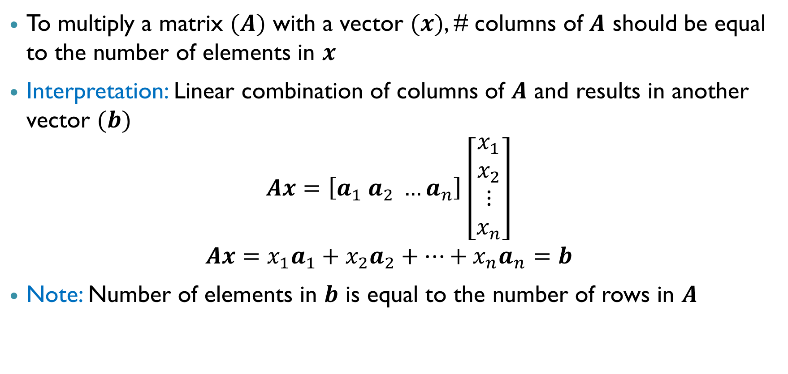
Matrix Multiplication with a Vector
To multiply a matrix $(A)$ with a vector $(x)$, # columns of $A$ should be equal to the number of elements in $x$
Interpretation: Linear combination of columns of $A$ and results in another vector $(b)$
$$Ax=\left[a_{1} a_{2} …a_{n}\right]\left[\begin{matrix}x_{1} \\ x_{2} \\ ⋮ \\ x_{n}\end{matrix}\right]$$
$$Ax=x_{1}a_{1}+x_{2}a_{2}+…+x_{n}a_{n}=b$$
Note: Number of elements in $b$ is equal to the number of rows in $A$

Slide 27



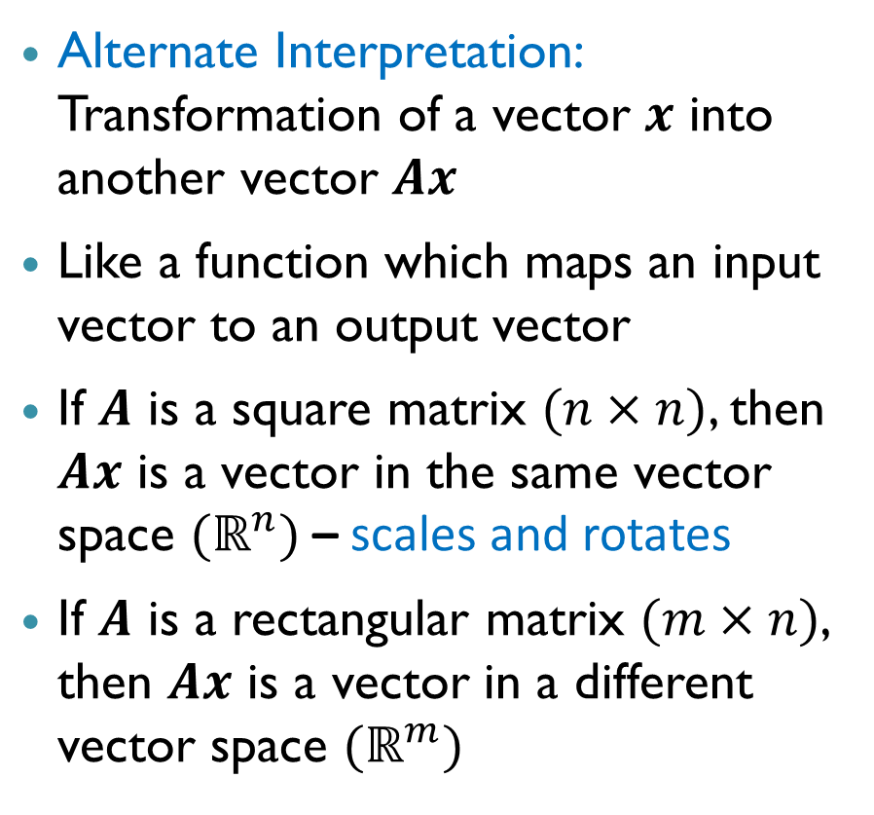



Matrix Multiplication with a Vector
Alternate Interpretation: Transformation of a vector $x$ into another vector $Ax$
Like a function which maps an input vector to an output vector
If $A$ is a square matrix $(n×n)$, then $Ax$ is a vector in the same vector space $(ℝ^{n})$ – scales and rotates
If $A$ is a rectangular matrix $(m×n)$, then $Ax$ is a vector in a different vector space $(ℝ^{m})$
$f:ℝ^{n}→$ $ℝ^{m}$
$$ℝ^{n}$$
$$ℝ^{m}$$
$$Ax=b$$
$$x$$
$$b$$

Slide 28
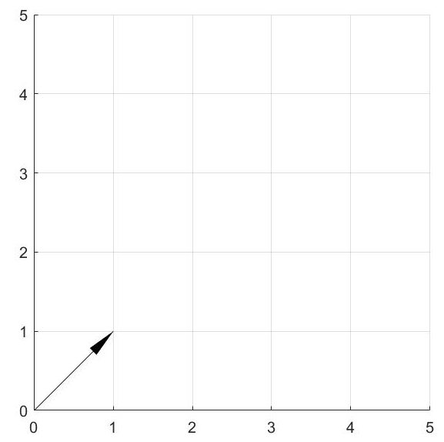
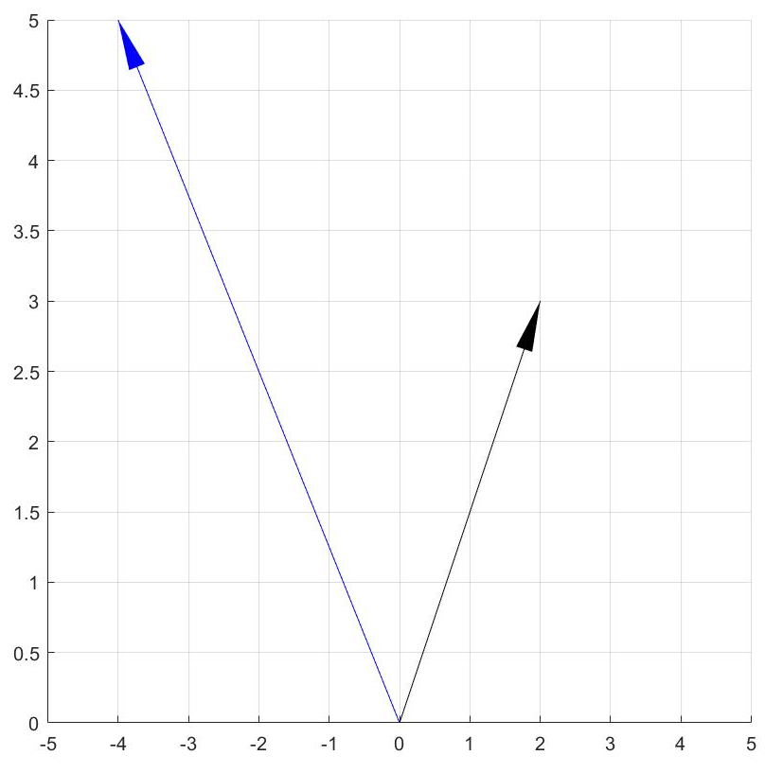
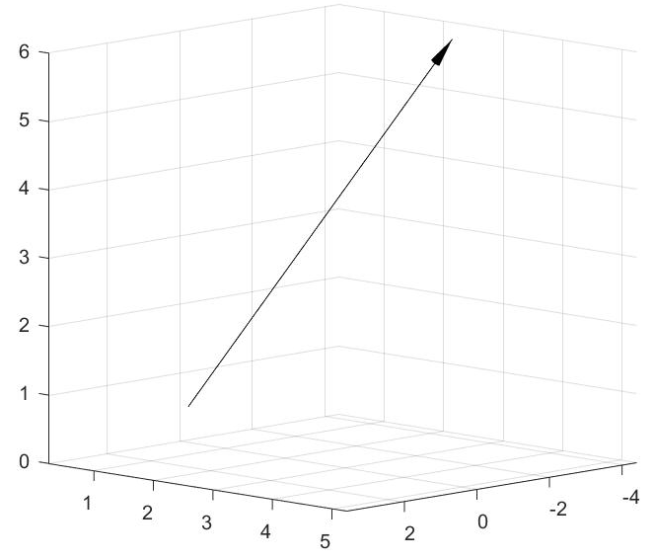
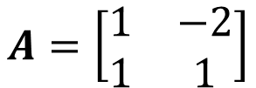
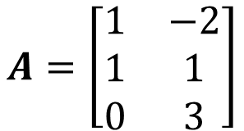






Matrix Multiplication with a Vector
$$A=\left[\begin{matrix}1 & −2 \\ 1 & 1\end{matrix}\right]$$
$$A=\left[\begin{matrix}1 & −2 \\ 1 & 1 \\ 0 & 3\end{matrix}\right]$$
$$Ax=\left[\begin{matrix}−4 \\ 5\end{matrix}\right]$$
$$Ax=\left[\begin{matrix}−3 \\ 3 \\ 6\end{matrix}\right]$$
$$x=\left[\begin{matrix}2 \\ 3\end{matrix}\right]$$
$$x=\left[\begin{matrix}1 \\ 2\end{matrix}\right]$$
$$ℝ^{2}$$
$$ℝ^{3}$$

Slide 29
Properties of Matrices

Slide 30

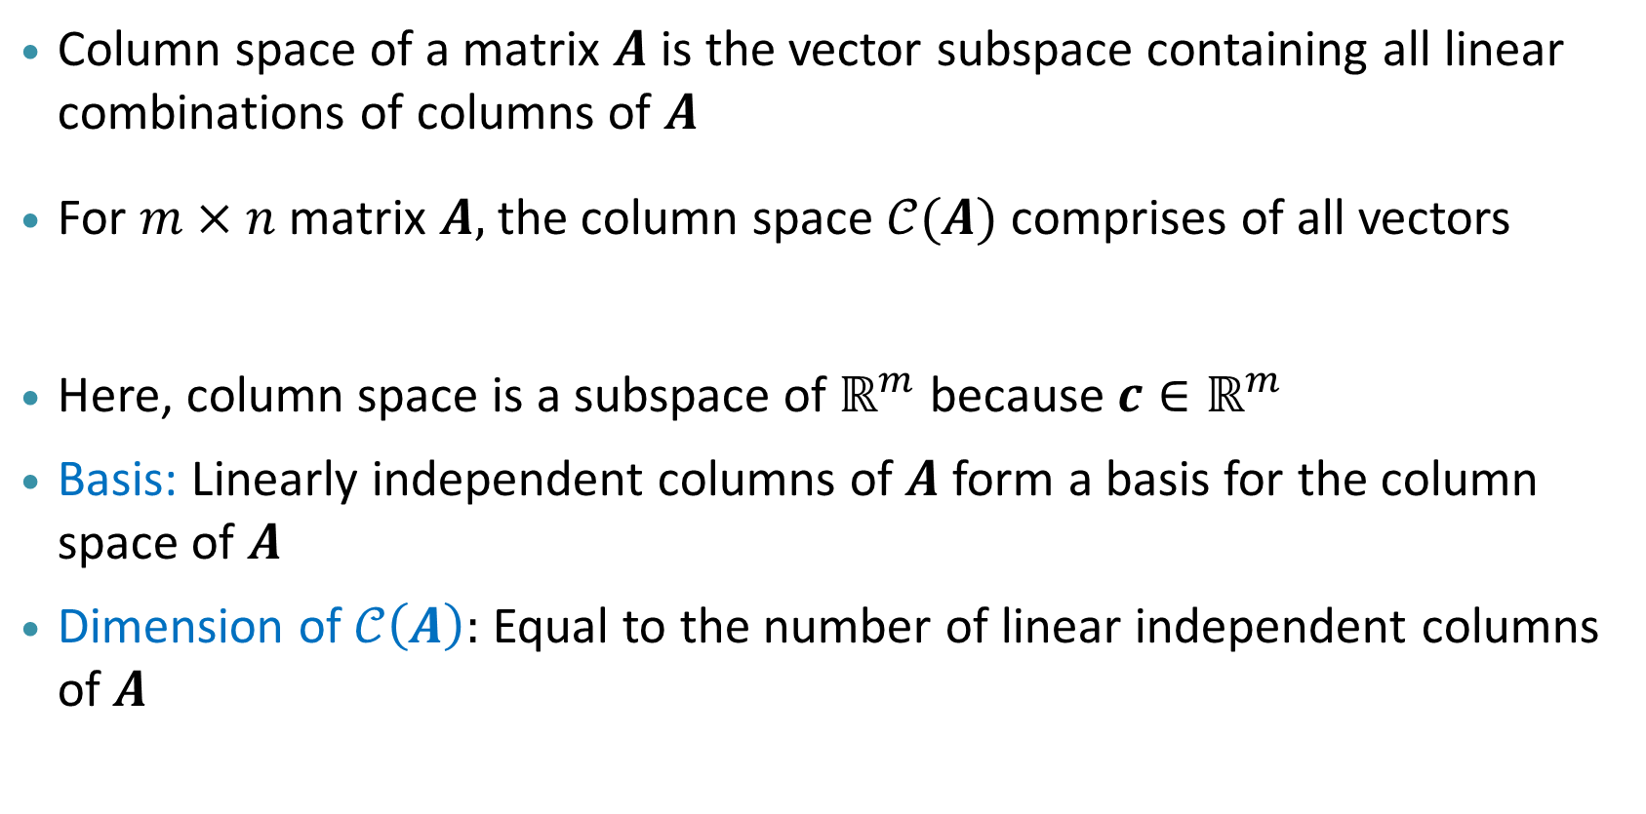
Matrix Subspaces: Column space or Image
Column space of a matrix $A$ is the vector subspace containing all linear combinations of columns of $A$
For $m×n$ matrix $A,$ the column space $𝒞(A)$ comprises of all vectors
Here, column space is a subspace of $ℝ^{m}$ because $c∈ℝ^{m}$
Basis: Linearly independent columns of $A$ form a basis for the column space of $A$
Dimension of $𝒞\left(A\right):$ Equal to the number of linear independent columns of $A$
$$c=Ax ∀ x∈ℝ^{n}$$

Slide 31

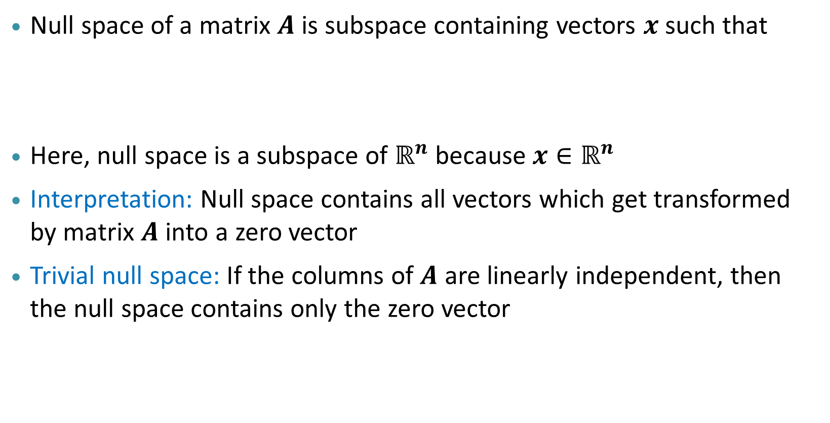
Matrix Subspaces: Null space or Kernel
Null space of a matrix $A$ is subspace containing vectors $x$ such that
Here, null space is a subspace of $ℝ^{n}$ because $x∈ℝ^{n}$
Interpretation: Null space contains all vectors which get transformed by matrix $A$ into a zero vector
Trivial null space: If the columns of $A$ are linearly independent, then the null space contains only the zero vector
$$𝒩\left(A\right)=x∈ℝ^{n}|Ax=0$$

Slide 32

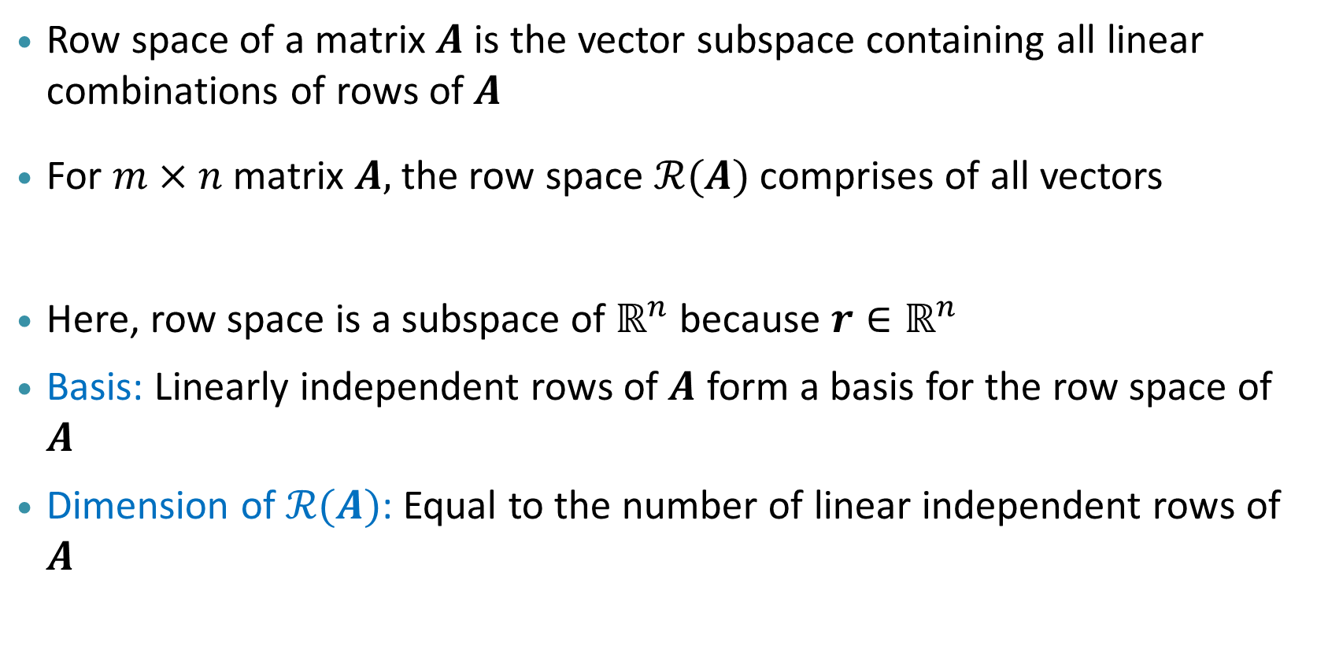
Matrix Subspaces: Row Space
Row space of a matrix $A$ is the vector subspace containing all linear combinations of rows of $A$
For $m×n$ matrix $A,$ the row space $ℛ(A)$ comprises of all vectors
Here, row space is a subspace of $ℝ^{n}$ because $r∈ℝ^{n}$
Basis: Linearly independent rows of $A$ form a basis for the row space of $A$
Dimension of $ℛ(A)$: Equal to the number of linear independent rows of $A$
$$r=A^{T}y ∀ y∈ℝ^{m}$$

Slide 33
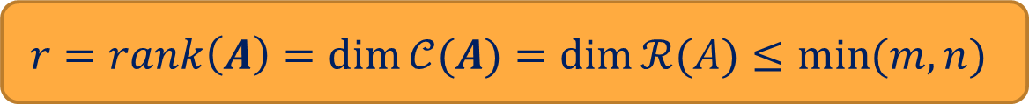
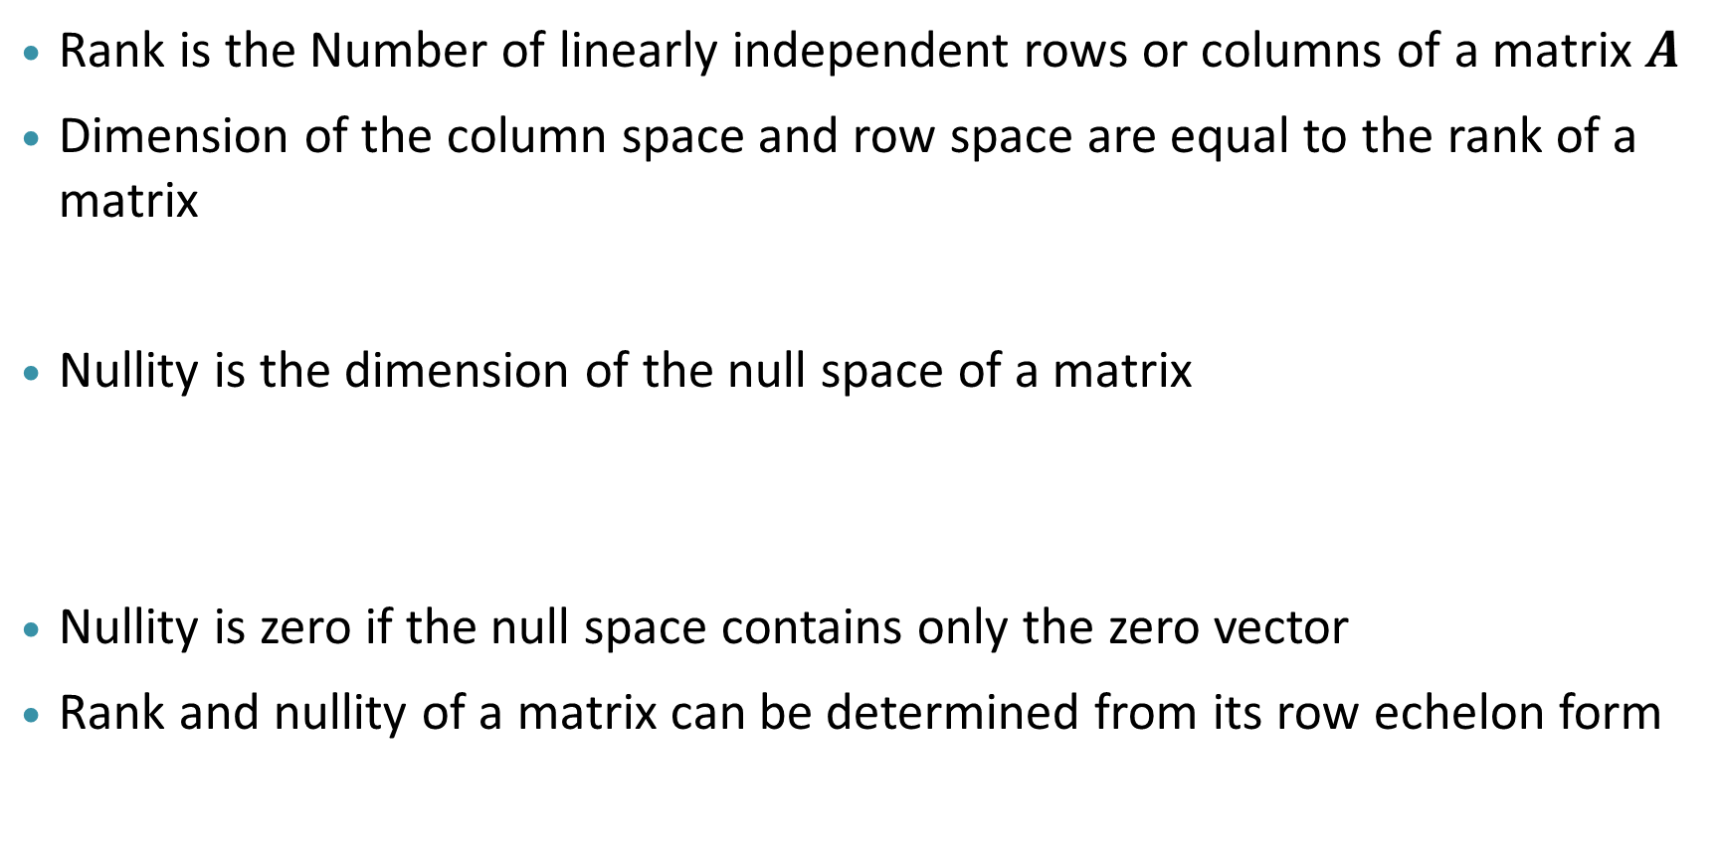

Rank and Nullity of a Matrix
Rank is the Number of linearly independent rows or columns of a matrix $A$
Dimension of the column space and row space are equal to the rank of a matrix
Nullity is the dimension of the null space of a matrix
Nullity is zero if the null space contains only the zero vector
Rank and nullity of a matrix can be determined from its row echelon form
$$r=rank\left(A\right)=\dim{𝒞(A)}=\dim{ℛ(A)}≤\min{(m,n)}$$
Nullity$(A)=\dim{𝒩(A)}$

Slide 34

Rank of a matrix: Example
Consider
$$A=\left[\begin{matrix}1 & 2 & 1 \\ 2 & 4 & 0 \\ 3 & 6 & 0\end{matrix}\right]$$
Observe that
(Col. 2)=2 x (Col. 1)
(Col. 3) is independent
Thus, the rank of this matrix is 2 and nullity is 1

Slide 35


Full Rank Matrix
Matrix having full column rank: $rank\left(A\right)=\#$columns of $A$
Matrix having full row rank: $rank\left(A\right)=\#$rows of $A$
Matrix is said to have full rank when it has full column rank or full row rank
A $m×m$ square matrix has full rank when: $r=m$
Nullity of a full rank square matrix is zero
Rank deficient matrix: A matrix not having full rank
$$r=rank\left(A\right)=\min{(m,n)}$$

Slide 36


Results relating Matrix Subspaces
Rank-Nullity Theorem:
For an $m×n$ matrix $A:$
$rank\left(A\right)+nullity\left(A\right)=n$
$rank\left(A^{T}\right)+nullity\left(A^{T}\right)=m$
Fundamental theorem of Linear Algebra:
Null space of a matrix is orthogonal to its row space: $𝒩\left(A\right)=ℛ{\left(A\right)}^{⊥}$
Left null space of a matrix is orthogonal to its column space: $𝒩\left(A^{T}\right)=𝒞{\left(A\right)}^{⊥}$
Name | Subspace of | Dimension
Column space - $𝒞(A)$ | $$ℝ^{m}$$ | $$r$$
Null space - $𝒩\left(A\right)$ | $$ℝ^{n}$$ | $$n−r$$
Row space - $ℛ(A)$ | $$ℝ^{n}$$ | $$r$$
Left null space - $𝒩\left(A^{T}\right)$ | $$ℝ^{m}$$ | $$m−r$$

Slide 37
















Relation between Matrix Subspaces
$$ℛ(A)$$
$$𝒞(A)$$
$$Ax_{r}=b$$
$$x_{r}$$
$$b$$
dim $r$
dim $r$
$$A(x_{r}+x_{n})=b$$
$$ℝ^{n}$$
$$ℝ^{m}$$
$$Ax_{n}=0$$
$$𝒩(A)$$
$$𝒩(A^{T})$$
$$x_{n}$$
dim $n−r$
dim $m−r$

Slide 38

Determinant, Inverse, Singularity and Rank of a Square Matrix
Consider a square matrix $A$ of size $m×m$
Following statements are equivalent:
$\det{A}≠0$
$A$ is invertible
$r=rank\left(A\right)=m$
$A$ has $m$ linearly independent rows and $m$ linearly independent columns
$A$ is a non-singular matrix
$nullity \left(A\right)=0$ and null space contains only the zero vector
Note: All the converse statements are also equivalent

Slide 39
Eigenvectors and Eigenvalues

Slide 40







Eigenvectors and Eigenvalues
Let $A$ be a square matrix
Recall: $Ax$ transforms vector $x$ into a new vector having a different magnitude (scaled) and direction
Question: Are there vectors which do not change direction when multiplied by $A$?
Eigenvectors: Special vectors which do not change direction but only scale in magnitude when transformed by A
Scaling factor is referred to as eigenvalue $(λ)$
$$A=\left[\begin{matrix}1 & 2 \\ 2 & 1\end{matrix}\right]$$
$$Ax=\left[\begin{matrix}3 \\ 3\end{matrix}\right]=3\left[\begin{matrix}1 \\ 1\end{matrix}\right]$$
$$x=\left[\begin{matrix}1 \\ 1\end{matrix}\right]$$
$$Ax=λx$$
$$λ=\frac{|Ax|}{|x|}$$

Slide 41

Finding Eigenvalues and Eigenvectors
We can find the eigenvalues as follows
$$Ax=λx$$
$$Ax−λIx=0$$
$$\left(A−λI\right)x=0$$
$A−λI$ should have a non-trivial null space
Thus, the eigenvalues can be determined by solving:
$$|A−λI|=0$$
Substituting the eigenvalues in the original equation will help us find solutions for the eigenvector $x$

Slide 42
Eigenvalues and eigenvectors: Examples
Consider the following example with the given A matrix
$$A=\left[\begin{matrix}8 & 7 \\ 2 & 3\end{matrix}\right]$$
$$\left[\begin{matrix}8 & 7 \\ 2 & 3\end{matrix}\right]\left[\begin{aligned}x_{1} \\ x_{2}\end{aligned}\right]=λ\left[\begin{aligned}x_{1} \\ x_{2}\end{aligned}\right]=\left[\begin{aligned}{λx}_{1} \\ {λx}_{2}\end{aligned}\right]$$
$$\left|A−λI\right|=\left|\left[\begin{matrix}8 & 7 \\ 2 & 3\end{matrix}\right]−λ\left[\begin{matrix}1 & 0 \\ 0 & 1\end{matrix}\right]\right|=\left|\left[\begin{matrix}8−λ & 7 \\ 2 & 3−λ\end{matrix}\right]\right|=0$$
$$\left(8−λ\right)\left(3−λ\right)−14=0$$
$$λ^{2}−11λ+10=0$$
$$λ=(10,1)$$
Thus we identify two eigenvalues and now we proceed to find the corresponding eigenvectors

Slide 43
Eigenvalues and eigenvectors: Examples
$$\left[\begin{matrix}8 & 7 \\ 2 & 3\end{matrix}\right]\left[\begin{aligned}x_{1} \\ x_{2}\end{aligned}\right]=λ\left[\begin{aligned}x_{1} \\ x_{2}\end{aligned}\right]$$
$λ=1$
$$\left[\begin{matrix}8 & 7 \\ 2 & 3\end{matrix}\right]\left[\begin{aligned}x_{1} \\ x_{2}\end{aligned}\right]=\left[\begin{aligned}x_{1} \\ x_{2}\end{aligned}\right]$$
$$\left[\begin{aligned}{8x}_{1}+7x_{2} \\ 2x_{1}+3x_{2}\end{aligned}\right]=\left[\begin{aligned}x_{1} \\ x_{2}\end{aligned}\right]$$
$$x_{1}+x_{2}=0$$
Thus the eigenvector (unit) corresponding to $λ=1$is
$$X=\left[\begin{aligned}\frac{1}{\sqrt{2}} \\ \frac{−1}{\sqrt{2}}\end{aligned}\right]$$

Slide 44
Eigenvalues and eigenvectors: Examples
$λ=10$
$$\left[\begin{matrix}8 & 7 \\ 2 & 3\end{matrix}\right]\left[\begin{aligned}x_{1} \\ x_{2}\end{aligned}\right]=\left[\begin{aligned}{10x}_{1} \\ {10x}_{2}\end{aligned}\right]$$
$$\left[\begin{aligned}{8x}_{1}+7x_{2} \\ 2x_{1}+3x_{2}\end{aligned}\right]=\left[\begin{aligned}10x_{1} \\ {10x}_{2}\end{aligned}\right]$$
$$7x_{2}=2x_{1}$$
Thus the eigenvector (unit) corresponding to $λ=10$
$$X=\left[\begin{aligned}\frac{7}{\sqrt{53}} \\ \frac{2}{\sqrt{53}}\end{aligned}\right]$$

Slide 45

Properties of Eigenvalues and Eigenvectors
Let $λ_{1},…,λ_{m}$ be set of eigenvalues and $x_{1},…,x_{m}$ be corresponding eigenvectors of a square matrix $A$
Following are some of their properties:
Set of eigenvalues are unique but $x_{i}$ is not unique for a given $λ_{i}$
$$A(αx)=λ(αx)$$
If $λ_{1},…,λ_{m}$are distinct, then $x_{1},…,x_{m}$are linearly independent
$λ_{1}λ_{2}…λ_{m}=\det{A}$
$λ_{1}+λ_{2}+…+λ_{m}=$ Sum of diagonal elements of $A$ (trace)
Number of non-zero eigenvalues is equal to the rank of the matrix

Slide 46

Connection between Eigenvectors, Eigenvalues, Null space and Determinant
$Ax=λx$
Suppose one of the eigenvalues is equal to zero
$$Ax=0$$
Eigenvectors corresponding to zero eigenvalues are in the null space of the matrix
Implies: Null space is non-trial and matrix is rank deficient (not full rank)
Implies: $\det{A}=0$ and $A$ is not invertible

Slide 47


Eigen Value Decomposition (EVD)
Decomposition of Matrix $A$ with $n$ linearly independent eigenvectors (distinct eigenvalues)
Columns of $E$ are eigenvectors of $A$
$E=[\begin{matrix}x_{1} & x_{2} & … & x_{m}\end{matrix}]$
$D$ is a diagonal matrix with eigenvalues along the diagonal
$$D=\left[\begin{matrix}λ_{1} & 0 & 0 \\ 0 & ⋱ & 0 \\ 0 & 0 & λ_{m}\end{matrix}\right]$$
$D$ is diagonalised form of matrix $A$ with both matrices having same eigenvalues
$$A=EDE^{−1 }$$

Slide 48


Eigenvalues and Eigenvectors of a Symmetric Matrix
Symmetric matrix $A_{s}$ of size $n×n$ has $n$ distinct eigenvalues and $n$ linearly independent eigenvectors
Eigenvectors of a symmetric matrix are always orthogonal (or orthonormal) i.e., $E^{−1}=E^{T}$
Eigenvalue decomposition of a symmetric matrix takes a special form:
$$A=EDE^{−1 }$$
All symmetric matrices are diagonalisable
$$A_{s}=EDE^{T}$$

Slide 49
Singular Values and Singular Vectors

Slide 50


Singular Values and Singular Vectors
Recall: Eigenvalues and eigenvectors are defined only for square matrices
Question: Can something similar to eigenvalues and vectors be defined for any matrix in general (square or rectangular)?
$σ$ is a singular value and $u$ and $v$ are corresponding singular vectors of a matrix $A$ of size $m×n$ if:
Note: $u$ has $m$ elements i.e., $u∈ ℝ^{m}$ and $v$ has $n$ elements i.e., $v∈ ℝ^{n}$
A set of orthogonal vectors in $ℝ^{m}$ and $ℝ^{n}$ which satisfy the above condition for any given matrix $A$
$$Av=σu$$
$$A^{T}u=σv$$

Slide 51

Properties of Singular values and Singular vectors
Let $σ_{1},σ_{2}…$ be the set of singular values and $u_{1},u_{2}…$ and $v_{1},v_{2},…$ be corresponding pairs of singular vectors of a matrix $A$
Following are some of their properties:
Set of singular values are unique but $u_{i}$ and $v_{i}$ is not unique for a given $σ_{i}$
Number of non-zero singular values is equal to the rank of the matrix
Set of vectors $u_{1},u_{2},…$ and set of vectors $v_{1},v_{2},…$ are orthogonal (or orthonormal)

Slide 52




Interpretation of Singular values and Singular vectors
Interpretation 1: A set of orthonormal vectors $(v_{1},v_{2},…)$ in an input space get mapped to a set of orthonormal vectors $(u_{1},u_{2},…)$ in an output space
Suppose $v_{i}$ and $u_{i}$ correspond to highest singular value $σ_{i}$
Interpretation 2: Input vector is transformed by the matrix to an output vector along which maximum scaling happens
$f:ℝ^{n}→$ $ℝ^{m}$
$$ℝ^{n}$$
$$ℝ^{m}$$
$$Av=σu$$
$$v$$
$$u$$

Slide 53



Relation between Eigenvalues and Singular values
Question: How to find a relation between eigenvalues and singular values when $λ_{i}$ are defined only for square matrices?
Any matrix can be turned into a square matrix by multiplying with its transpose: $A^{T}A$ or $AA^{T}$ (Symmetric matrices)
Note: Non-zero eigenvalues of $A^{T}A$ and $AA^{T}$ are the same
$$A^{T}Ax=λx$$
$$AA^{T}y=λy$$
$$Av=σu$$
$$A^{T}u=σv$$
Eigenvalues and singular values are equal for a symmetric matrix
Dimensions:
$$A −m×n$$
$$A^{T}A−n×n$$
$$AA^{T}−m×m$$
$$x_{i}−n×1$$
$$y_{i}−m×1$$
$$u_{i}−m×1$$
$$v_{i}−n×1$$
$$σ=λ$$

Slide 54

Relation between Eigenvectors and Singular vectors
$$A^{T}Ax=λx$$
$$AA^{T}y=λy$$
$$Av=σu$$
$$A^{T}u=σv$$
$A^{T}A$ is symmetric and hence its eigenvectors $x_{1},…,x_{m}$are orthogonal
$AA^{T}$is symmetric and hence its eigenvectors $y_{1},…,y_{n}$are orthogonal
Also, singular vectors $u_{1},u_{2},…$ and $v_{1},v_{2},…$ are orthogonal
It can be shown that direction of $x_{i}$ is same as that of $v_{i}$ and direction of $y_{i}$ is same as that of $u_{i}$
Dimensions:
$$A −m×n$$
$$A^{T}A−n×n$$
$$AA^{T}−m×m$$
$$x_{i}−n×1$$
$$y_{i}−m×1$$
$$u_{i}−m×1$$
$$v_{i}−n×1$$

Slide 55
Singular Value Decomposition

Slide 56


Singular Value Decomposition (SVD)
SVD is a generalization of EVD to any matrix
SVD is a very powerful technique useful in many applications
Any $m×n$ matrix $A$ can be factorized into three matrices based on singular values and singular vectors
Columns of $U$: Left singular vectors $u$ (or) eigenvectors of $AA^{T}$
Columns of $V$: Right singular vectors $v$ (or) eigenvectors of $A^{T}A$
Matrix $S$ has singular values of $A$ along the main diagonal
$$A_{m×n} =U_{m×m}S_{m×n}V_{n×n}^{T }$$

Slide 57


Singular Value Decomposition - Example
Example:
$A=$
SVD of $A$ is given by:
$A$ =
U
$$S$$
V^{T}

Slide 58
Summary
Vectors representation in a vector space
Vectors properties of magnitude, direction, addition, scaling and dot product
Linear combination and linear independence of vectors
Span and basis of a vector space
Projection and Matrix multiplication of a vector
Matrix subspaces- column space, null space and row space
Rank and nullity of a matrix

Slide 59
Summary – Cont…
Eigenvalues and Eigenvectors of a matrix
Eigen Value Decomposition of a matrix
Singular values and Singular vectors of a matrix
Singular Value Decomposition
What is the relevance of these concepts in relation to Data Science?

Slide 60
Vector and Matrix Properties Applied to Data Matrix

Slide 61




Data Matrix
Data Matrix - $X_{m×n}×n$
Consider a data matrix with $m$ features (rows) and $n$ samples (columns)
There are $n$ feature vectors each having $m$ elements
Visualisation: Each feature represents a dimension of the vector space having $m$ dimensions
All $n$ feature vectors can be represented in the $m$-dimensional vector space
 | Sample 1 | Sample 2 | $$…$$
Feature 1
Feature 2
$$⋮$$
Rows:
Features
Columns: Samples
Feature 3
$$x=\left[\begin{matrix}x_{1} \\ x_{2} \\ x_{3}\end{matrix}\right]$$
Feature 1
Feature 2

Slide 62




Finding Number of Independent Features
Suppose among the $m$ features only $k$ of them are independent while the rest are dependent (linearly)
Implies: $m−k$ features can be determined from the $k$ independent features
$m$ features
$k$ independent features
$m−k$ dependent features

Slide 63

Finding Number of Independent Features
Suppose among the $m$ features only $k$ of them are independent while the rest are dependent (linearly)
Implies: $m−k$ features can be determined from the $k$ independent features
Question: How to determine the value of $k$ from data matrix?
Recall: Linearly independent rows and columns of a matrix
Here, each feature is a row and all features are not independent ($X$ is rank deficient)
Result: Number of independent features is equal to the number of linearly independent rows in the matrix
Implies: Number of independent features $=$ $rank(X)$
Note: Interpretation changes if the features are along the columns

Slide 64






Dimensionality Reduction
Feature $3$
Suppose there are too many features in the dataset
Question: How to reduce the number of features without losing information?
Answer: Project the feature vectors to a lower dimension space
$$p_{2}=\left[\begin{matrix}0 \\ 0 \\ x_{3}\end{matrix}\right]$$
$$x=\left[\begin{matrix}x_{1} \\ x_{2} \\ x_{3}\end{matrix}\right]$$
Feature $1$
$$p_{1}=\left[\begin{matrix}x_{1} \\ x_{2} \\ 0\end{matrix}\right]$$
Feature $2$

Slide 65
Dimensionality Reduction
Suppose there are too many features in the dataset
Question: How to reduce the number of features without losing information?
Answer: Project the feature vectors to a lower dimension space
Question: Which space to project and what is its basis ?
Answer: Find a space in which maximum information is retained when the vectors are projected
Basis of such a space can be obtained from Singular Value Decomposition (Singular vectors corresponding to high singular values)
Note: Whether left or right singular vectors are to be used depends on whether the features are along rows or columns

Slide 66

THANK YOU

